Slide 1

Crime and Unemployment: Any Correlation- The Case of Nashville, TN, Louisville, KY and Birmingham AL
Chiedozie M. Uhuegbu
Nashville Software School, DA10

Slide 2
Overview
My capstone will analyze crime data and police call-for-service records in three cities: Nashville, Tennessee; Louisville, Kentucky; and Birmingham, Alabama.
The project will also incorporate unemployment rate data from these cities to explore potential correlations and patterns.
The overarching goal is to understand how economic factors influence crime rates and the demand for police services in these urban areas.
I hope to analyze historical crime data to identify patterns in criminal activities such as theft, burglary, assault, vandalism, and more within the selected cities.
My capstone represents a comprehensive effort to understand the complex interplay between economic conditions, and public safety concerns.
Notes:
I anticipate that the results will provide valuable insights that can inform policy decisions and law enforcement strategies aimed at improving public safety and quality of life in metro cities in the south of America.

Slide 3
Where?
The data from Nashville, TN, is provided by the Metro Nashville Police Department, Information Technology,
For Louisville, KY, the Crime report data is provided for Louisville Metro Police Divisions
Birmingham, AL, is provided by four different police precincts, East, West, North, and South Police Precincts.

Slide 4
Data Gathering, cleaning and Manipulation
https://data.nashville.gov/Police/Metro-Nashville-Police-Department-Incidents/2u6v-ujjs/about_data
https://data.louisvilleky.gov/datasets/LOJIC::louisville-metro-ky-crime-data-2023/explore
https://data.birminghamal.gov/dataset/east-precinct-crime-data
https://data.birminghamal.gov/dataset/south-precinct-crime-data
https://data.birminghamal.gov/dataset/north-precinct-crime-data
https://data.birminghamal.gov/dataset/west-precinct-crime-data
Cleaned data within Python using dropna and pd.datetime month/year
Notes:
Gathered Data
Cleaned data within Python using dropna and pd.datetime month/year

Slide 5
Unemployment Data
https://beta.bls.gov/dataViewer/view/timeseries/LAUMT213114000000003
https://beta.bls.gov/dataViewer/view/timeseries/LAUMT011382000000003
https://beta.bls.gov/dataViewer/view/timeseries/LAUCA474000000000004

Slide 6
Why Unemployment and Crime Data?
37210 Zip code and Graduate School
provide valuable insights into the patterns, trends, and factors influencing criminal activities in various regions.
diverse demographic profiles
distinct geographic locations.
the South of the United States,
Notes:
I have chosen these crime data because I believe that crime data analysis will provide valuable insights into the patterns, trends, and factors influencing criminal activities in various regions. My proposal outlines a data analysis capstone project to analyze crime data and police call-for-service records in three cities: Nashville, Tennessee; Louisville, Kentucky; and Birmingham, Alabama. I selected the cities of Nashville, Louisville, and Birmingham due to their diverse demographic profiles and distinct geographic locations. Again, these cities are in the South of the United States, close to each other, and probably have a similar population.

Slide 7
close to each other, and
probably have a similar population.
have robust data collection and
reporting systems,
ensuring the availability of comprehensive and reliable data for the project.
Notes:
Furthermore, these cities have robust data collection and reporting systems, ensuring the availability of comprehensive and reliable data for the project.

Slide 8
Driving Questions
What are the most common types of crimes reported in each of the three cities, and how do they compare?
How do the rates of violent crimes, such as homicide and aggravated assault, compare across the three cities?
Are there any discernible patterns in the times of day or days of the week when crimes are most frequently reported in each city?

Slide 9

Louisville, KY
Notes:
Louisville, Kentucky's largest city, sits on the Ohio River along the Indiana border. Every May, its race course Churchill Downs hosts the Kentucky Derby, a renowned horse race whose long history is explored at the Kentucky Derby Museum. Baseball is celebrated at the Louisville Slugger Museum and Factory, where Major League bats are produced and a giant baseball "slugger" marks the entrance. Population size 1,116,000,

Slide 10
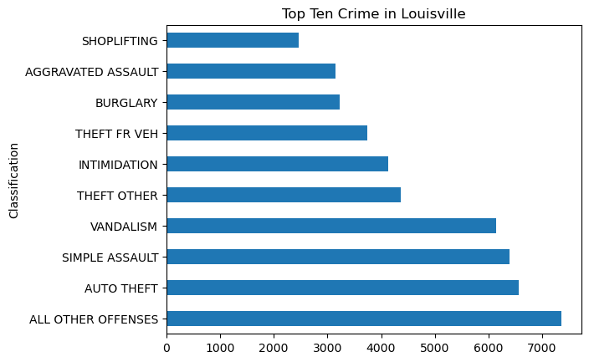

Slide 11
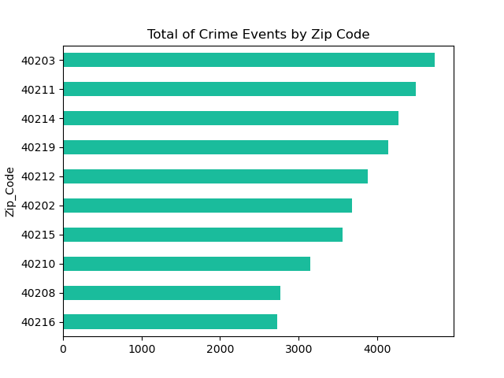
Notes:
The median household income of $15,535 is extremely low compared to the rest of the country. It is also extremely low compared to nearby ZIP codes. While money isn't everything, residents in ZIP code 40203 earn less than in other parts of town.
As with most parts of the country, vehicles are the most common form of transportation to places of employment. ZIP code 40203 uses public transportation to get to work more than almost anywhere in the country. Vs 40216 The median household income of $38,829 is slightly less than average compared to the rest of the country. It is also slightly higher than average compared to nearby ZIP codes. So 40216 is likely to be one of the nicer parts of town with a more affluent demographic.

Slide 12
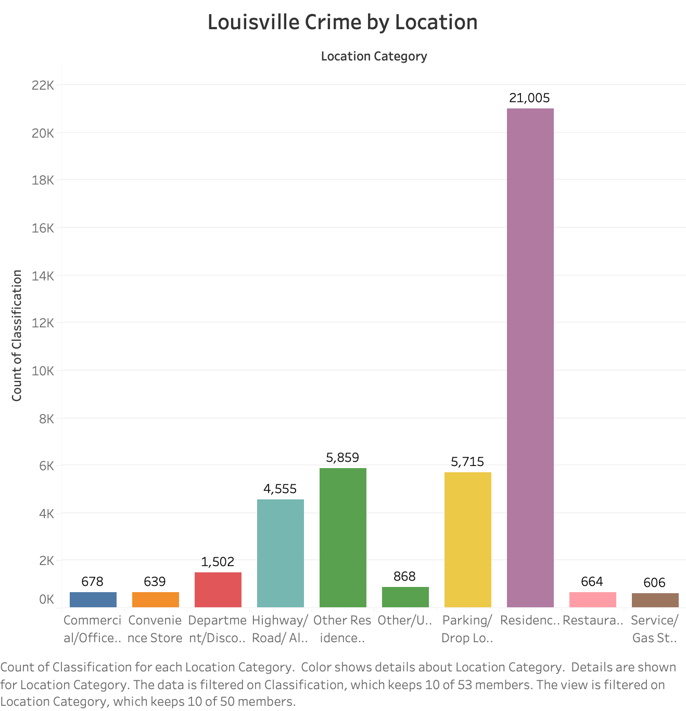

Slide 13
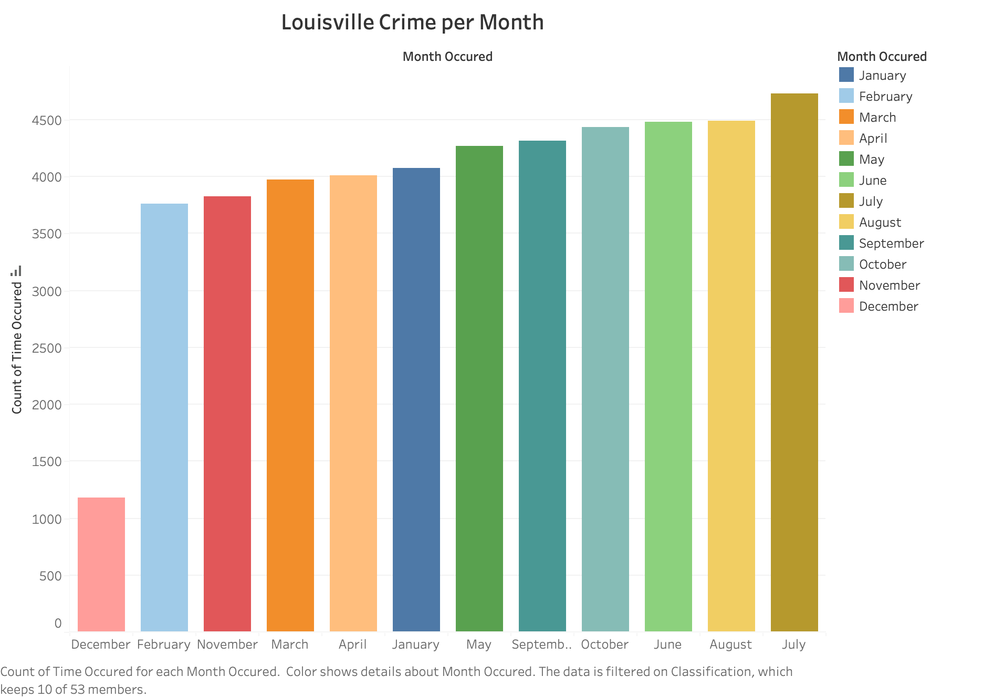

Slide 14
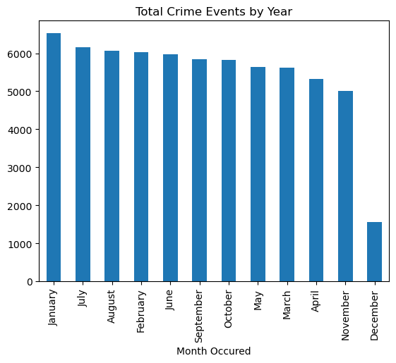
Louisville, Crime per Month

Slide 15
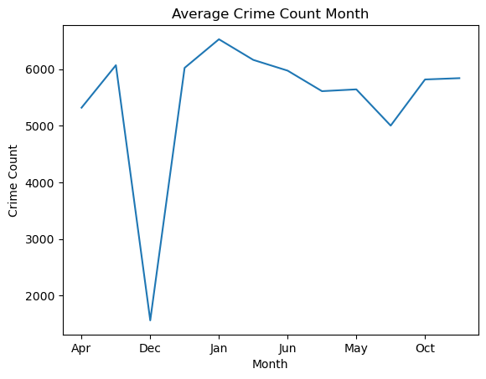
Louisville
Notes:
Most experts tie in the fact that heat leads to aggressive behaviors with other factors like an increase in daylight hours, young people being out of school, and more foot traffic in general outside of homes. A 2014 study, from the federal Bureau of Justice Statistics, looked at seasonal patterns in various types of crime in the US. The researchers went through surveys of crime victims from 1993 to 2010, and tried to figure out whether there statistical trends as to when crimes took place: during summer (June-August), fall (September-November), winter (December-February) or spring (March-May).
Because the study didn't include regional breakdowns, it's hard to tell whether it's warm weather that leads to more crime, or whether there's something else going on. And in most cases, the researchers didn't provide explanations for why these seasonal patterns existed. They just identified that the patterns exist.

Slide 16
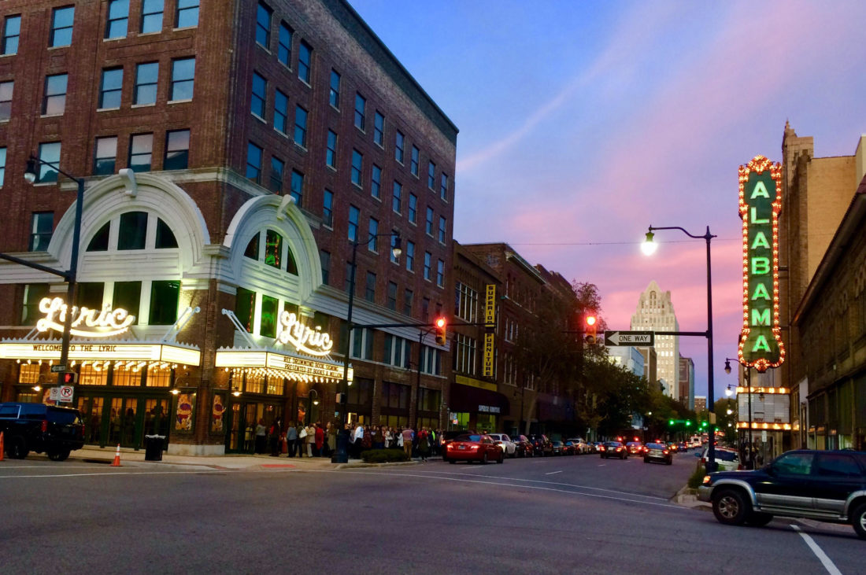
Birmingham, AL
Notes:
Birmingham is a city in the north central region of the U.S. state of Alabama. Birmingham is the seat of Jefferson County, Alabama's most populous county. 2,665,100

Slide 17
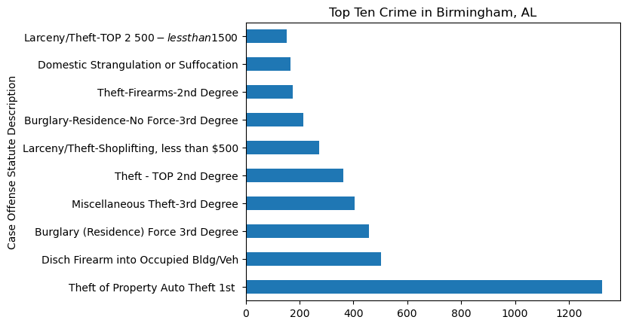

Slide 18
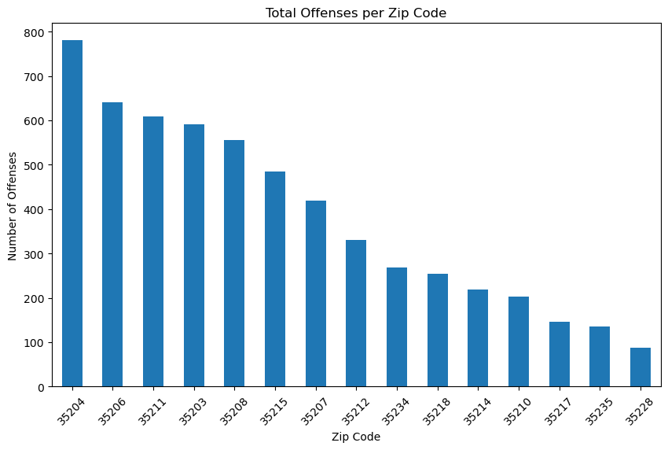
Notes:
The median household income of $20,894 is low compared to the rest of the country. It is also low compared to nearby ZIP codes. While money isn't everything, residents in ZIP code 35204 earn less than in other parts of town. 35338 The median household income of $32,013 is low compared to the rest of the country. It is also slightly higher than average compared to nearby ZIP codes. So 35228 is likely to be one of the nicer parts of town with a more affluent demographic. Compared to other ZIP codes in the country, 35228 has very few people that work at home. In most parts of the country, the majority of commuters get to work in under half an hour.
As with most parts of the country, vehicles are the most common form of transportation to places of employment. Residents in ZIP code 35204 use public transportation to travel to work more than most areas of the nation. Compared to other ZIP codes in the country, 35204 has very few people that work at home. In most parts of the country, the majority of commuters get to work in under half an hour. More commuters in 35204 get to experience these short commute times than most other ZIP codes. It is very uncommon, compared to the rest of the US, for employees to have to travel more than 45 minutes to their place of employment.

Slide 19
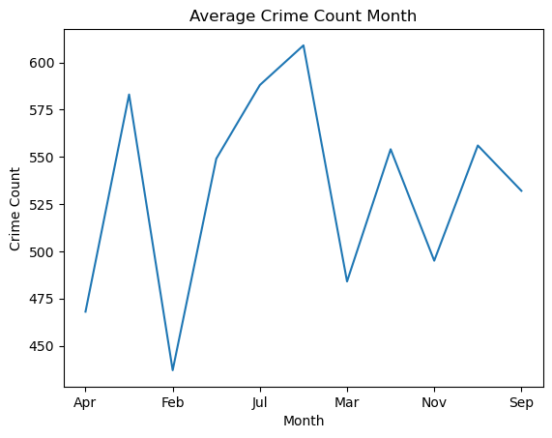
Birmingham, AVG per Month

Slide 20
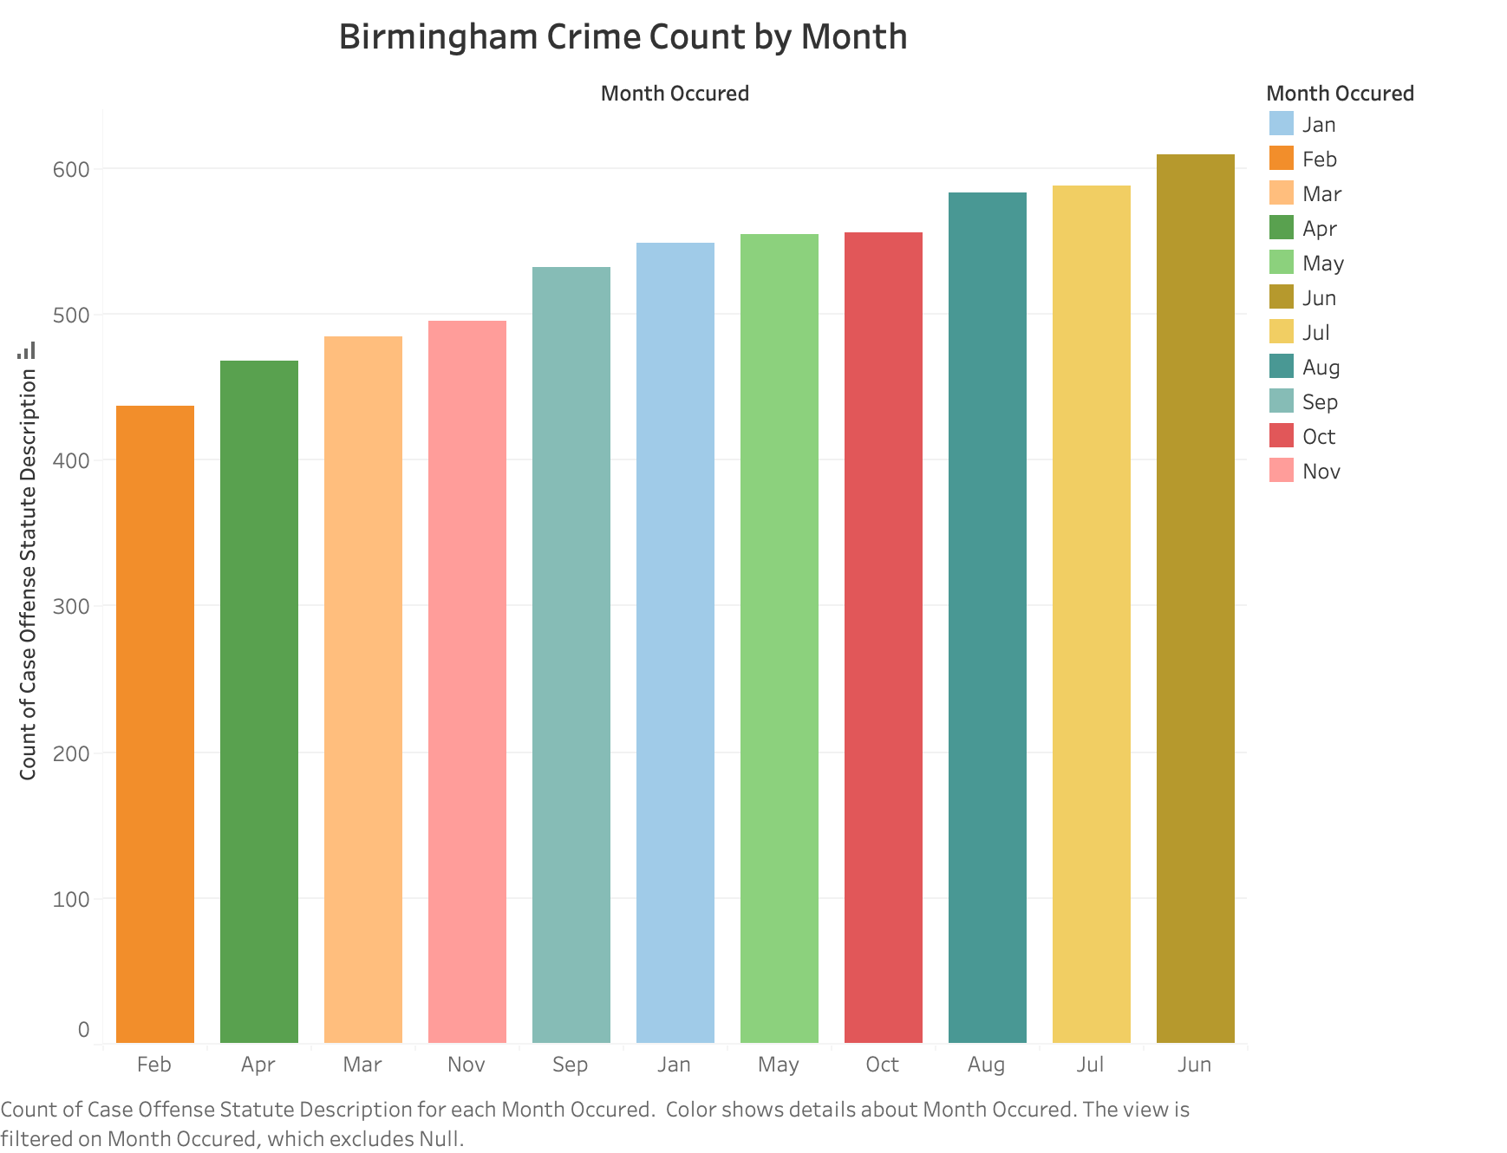

Slide 22
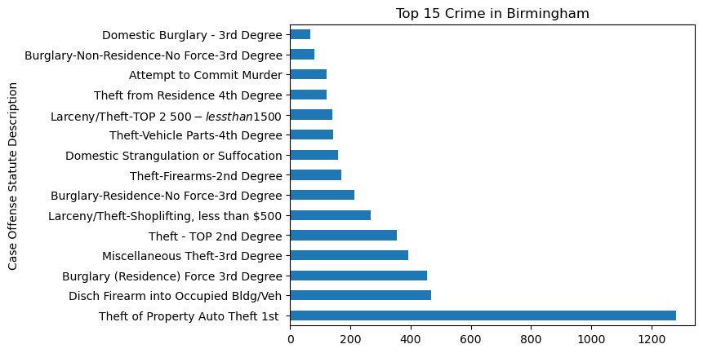

Slide 23
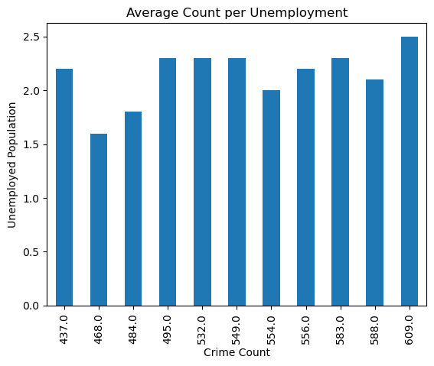

Slide 24
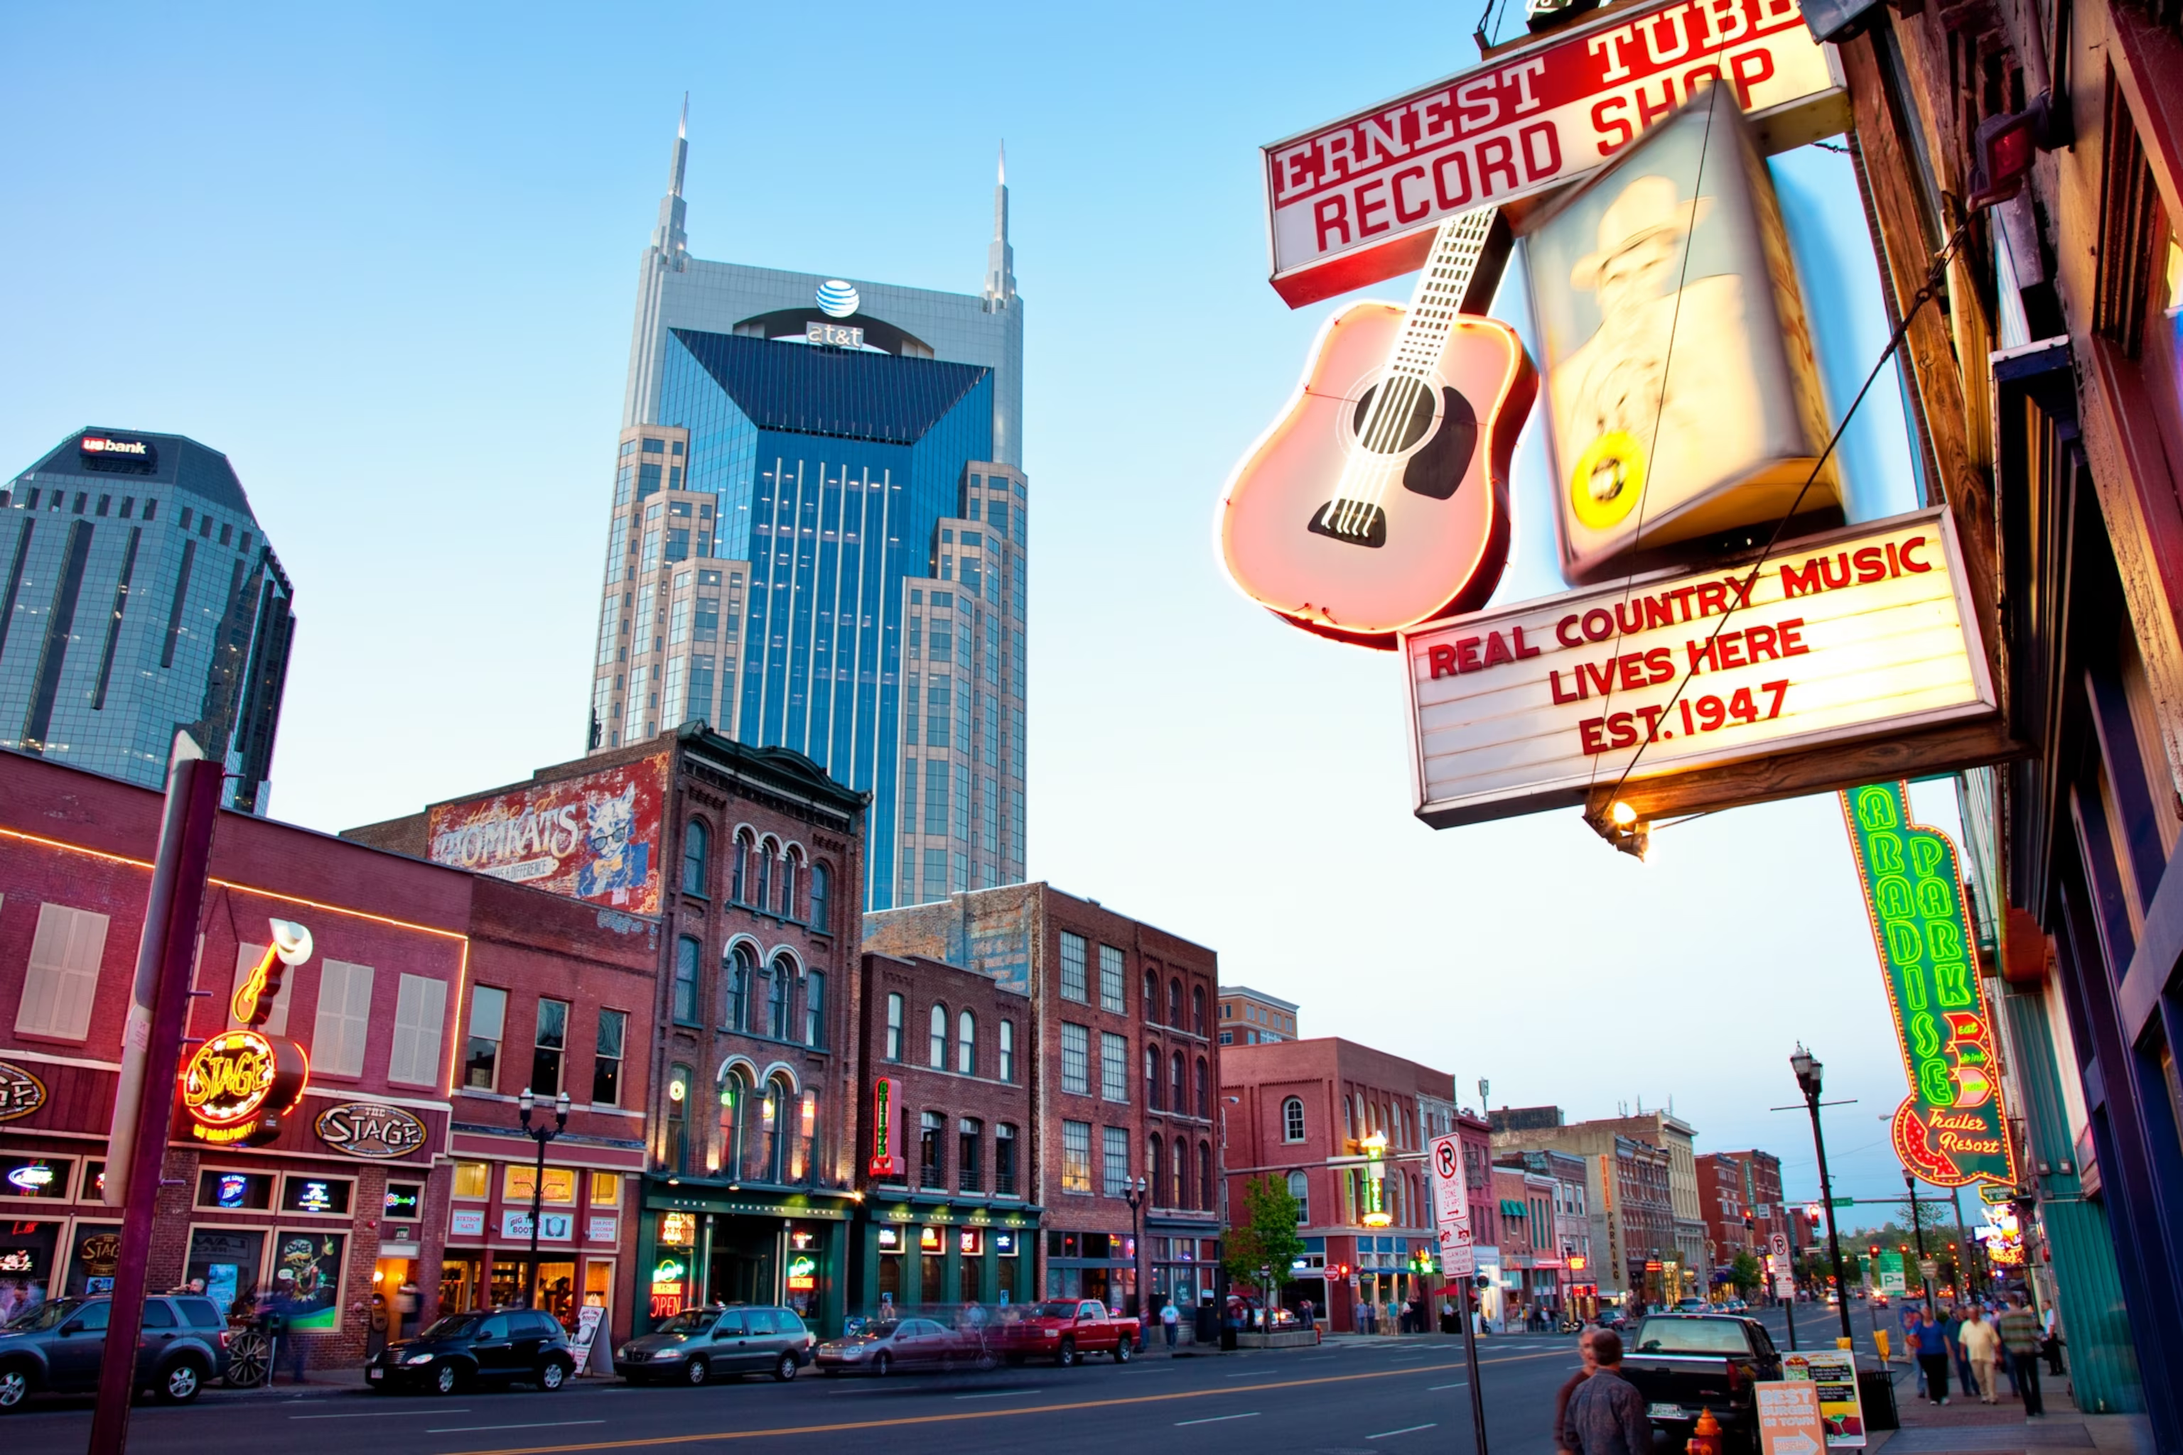
Nashville, TN
Notes:
Nashville is the capital of the U.S. state of Tennessee and home to Vanderbilt University. Legendary country music venues include the Grand Ole Opry House, home of the famous “Grand Ole Opry” stage and radio show. The Country Music Hall of Fame and Museum and historic Ryman Auditorium are Downtown, as is the District, featuring honky-tonks with live music and the Johnny Cash Museum, celebrating the singer's life. Nashville has a 2024 population of 1,315,000,

Slide 25
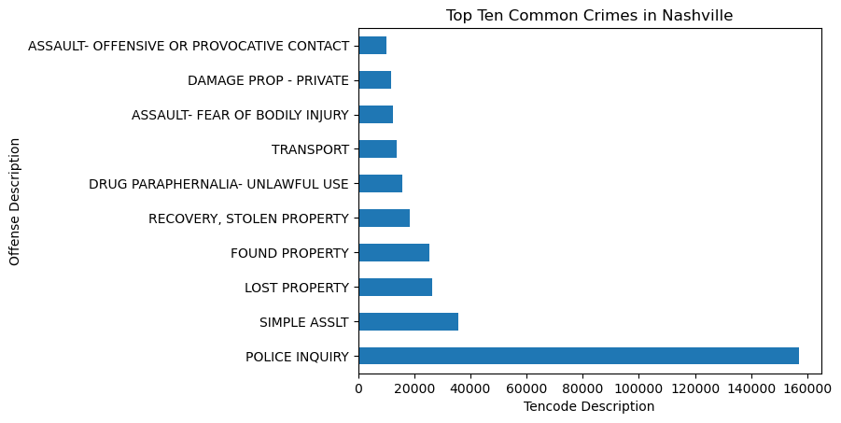

Slide 26
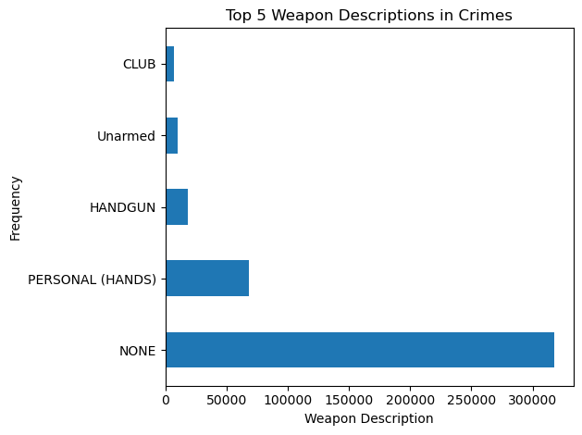

Slide 27
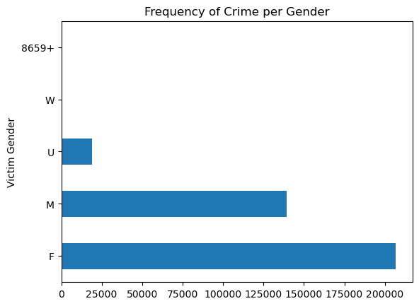

Slide 28
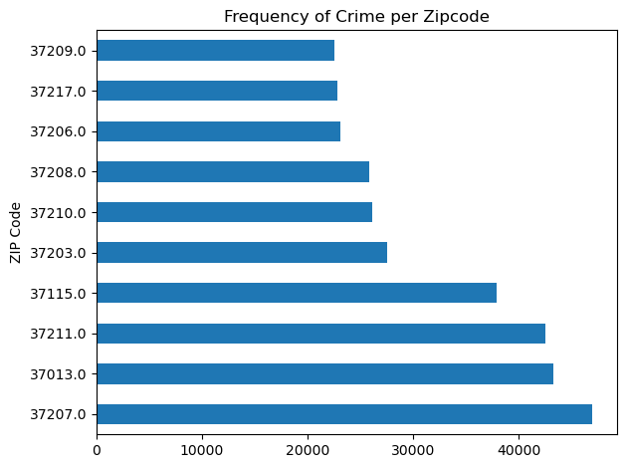
Notes:
Brick Church Bellshire. The median household income of $31,756 is low compared to the rest of the country. It is also slightly less than average compared to nearby ZIP codes. While money isn't everything, residents in ZIP code 37207 earn less than in other parts of town. As with most parts of the country, vehicles are the most common form of transportation to places of employment. In most parts of the country, the majority of commuters get to work in under half an hour. Vs 37209 The median household income of $43,625 is slightly less than average compared to the rest of the country. It is also slightly less than average compared to nearby ZIP codes. While money isn't everything, residents in ZIP code 37209 earn less than in other parts of town.

Slide 29
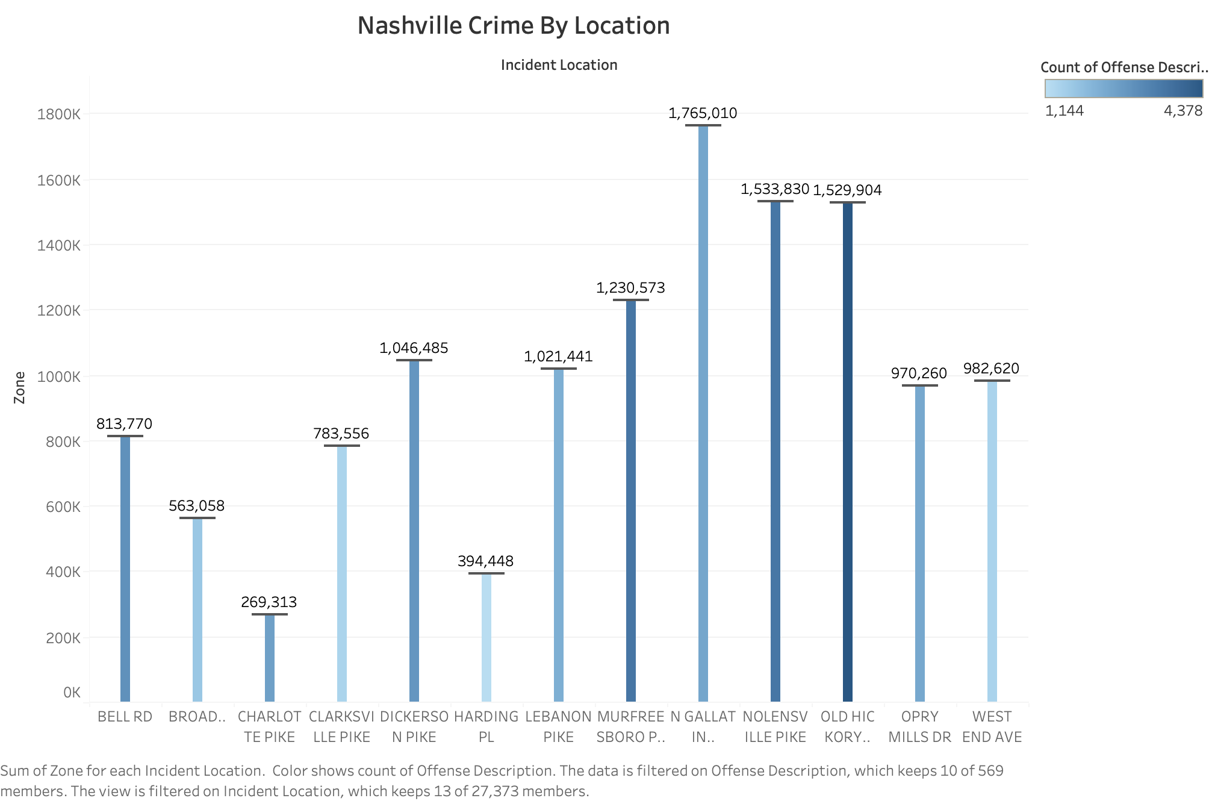

Slide 30
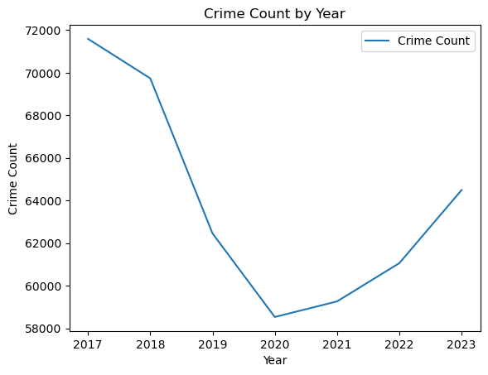
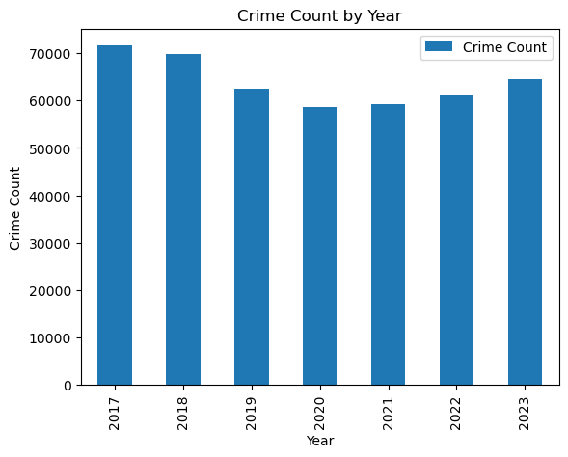

Slide 31
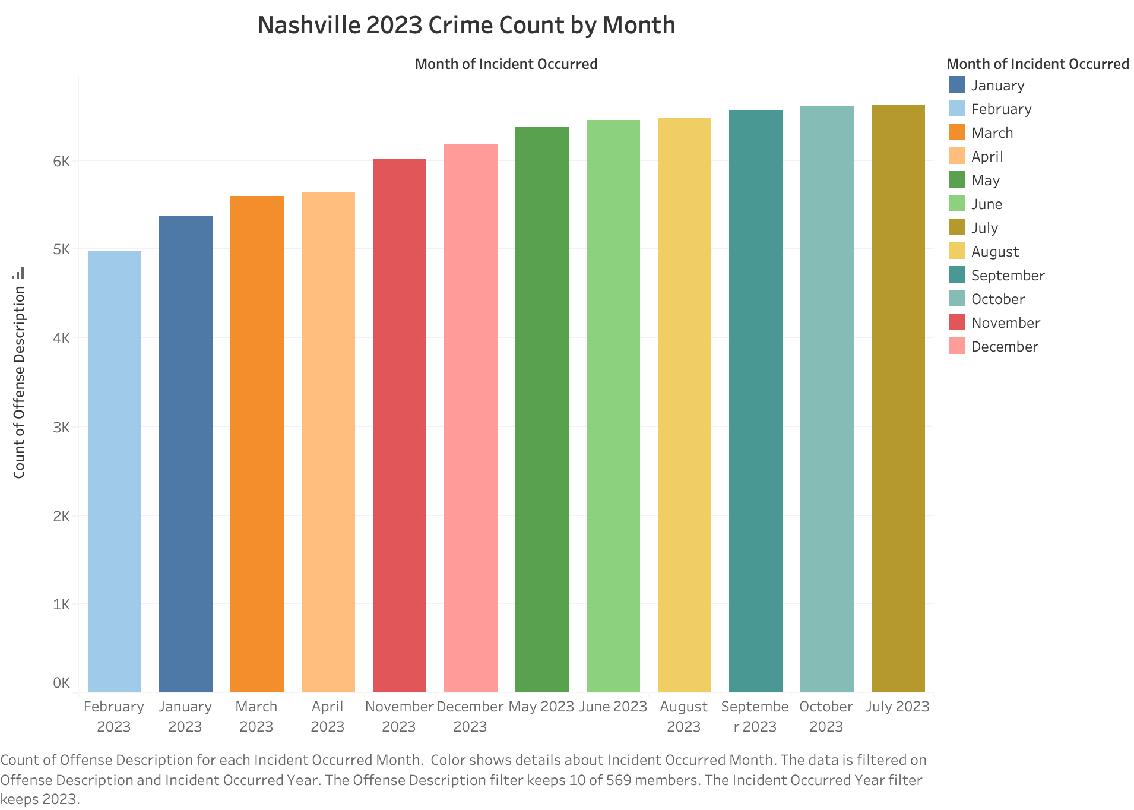

Slide 32
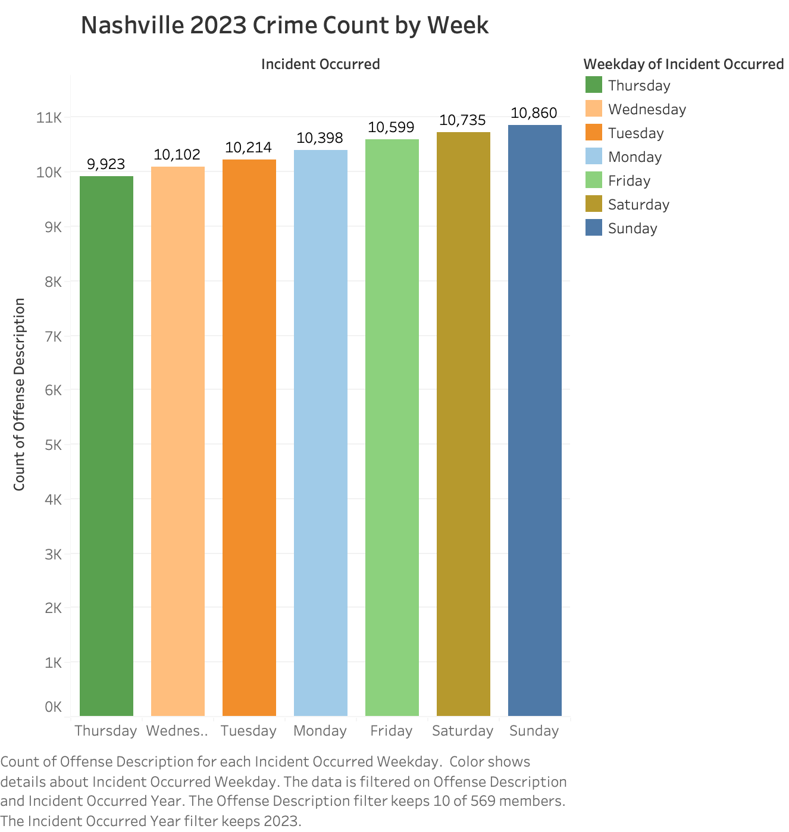

Slide 33
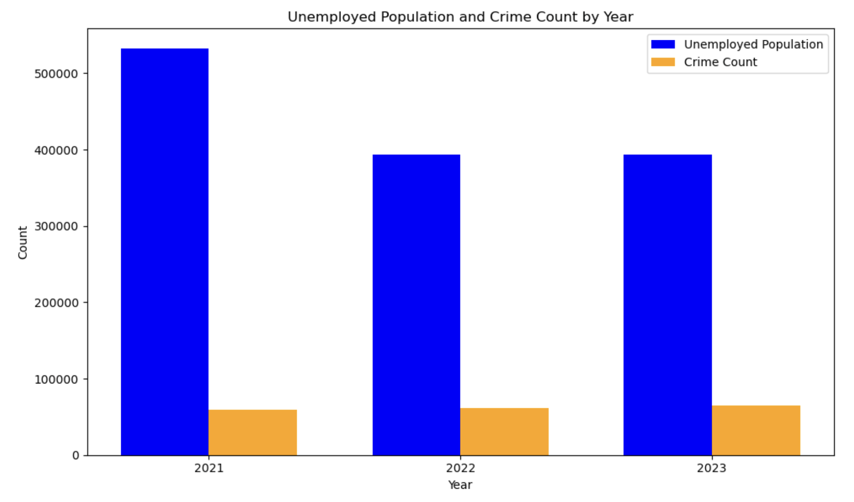
Unemployed Population and Crime Count by Year in Nashville

Slide 35
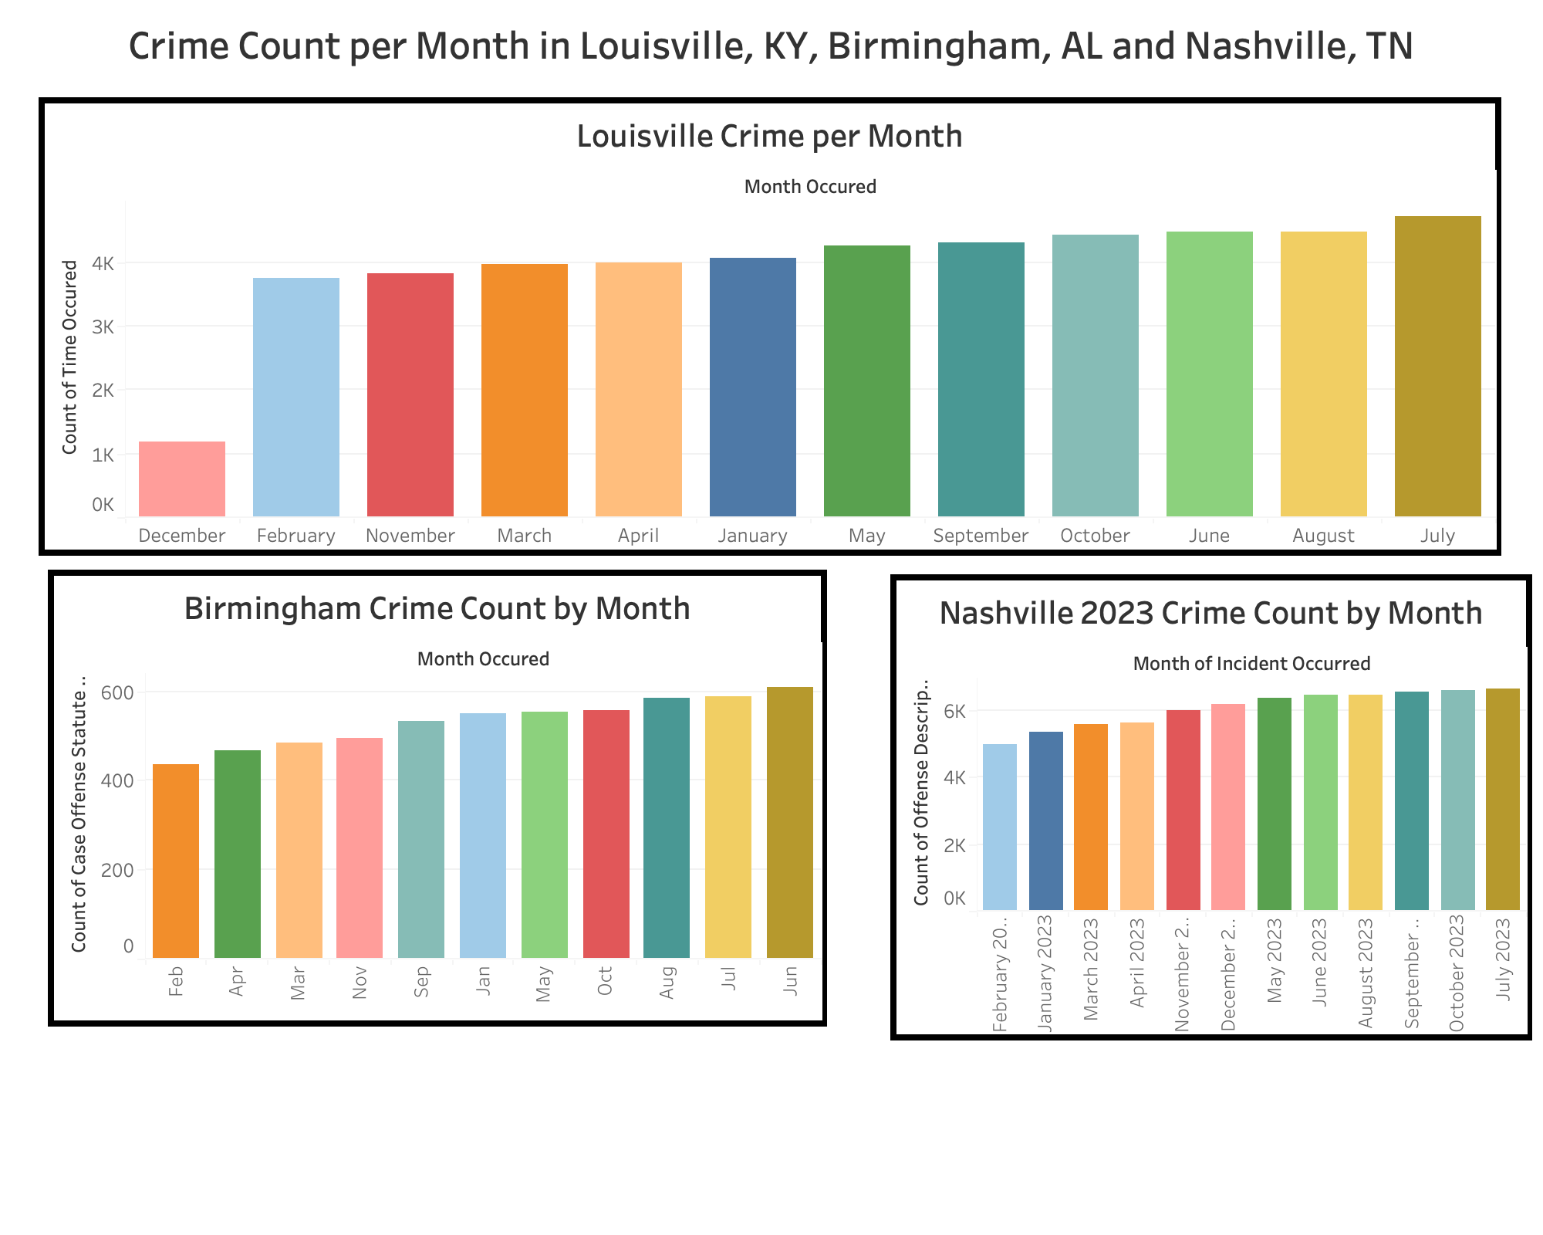

Slide 36

Conclusion and Recommendation?

